Slide 1
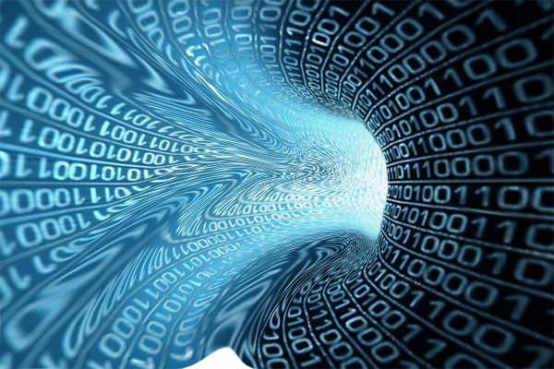
The
Evolution
of
Computing

Slide 2
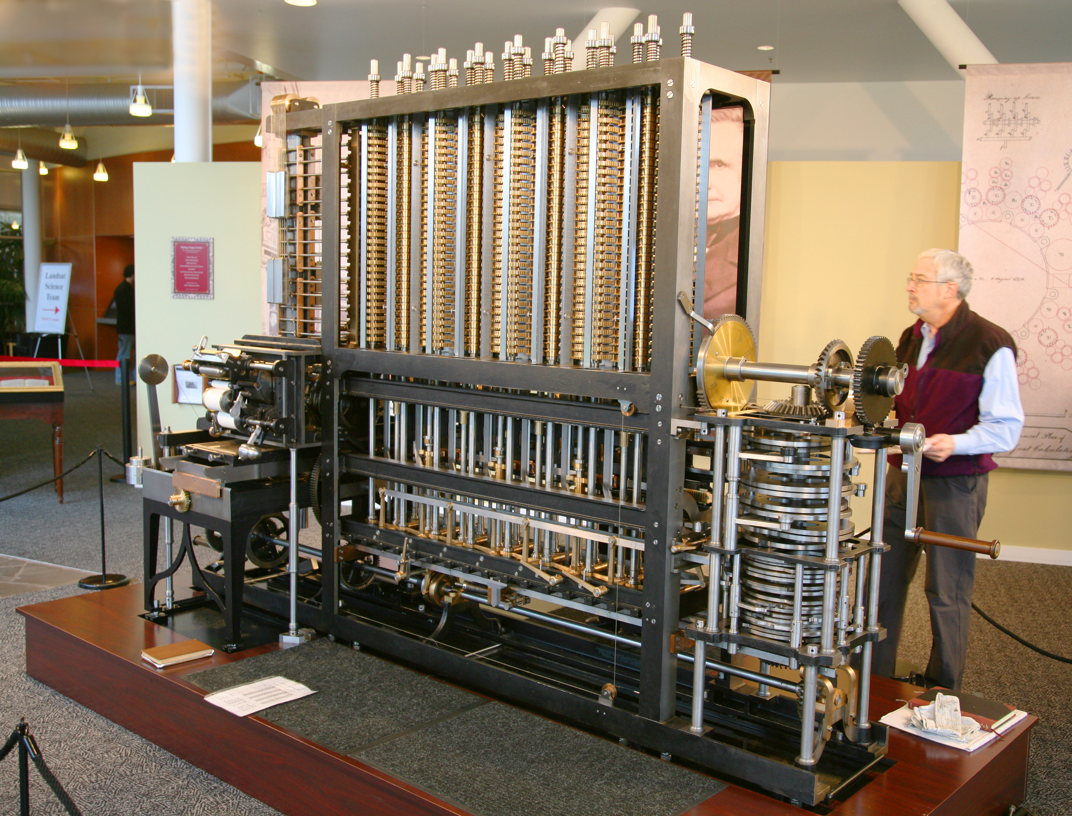
1. Babbage’s Difference Engine (1820-40s) U.K
Physical Specification:
13.6 Tonnes
2.5 m (High)
Never completed.
First operational version 1991.
Technical Specification:
Mechanical
Steam powered
Purpose
Producing mathematical tables
Military, Government.
London Science Museum

Slide 3
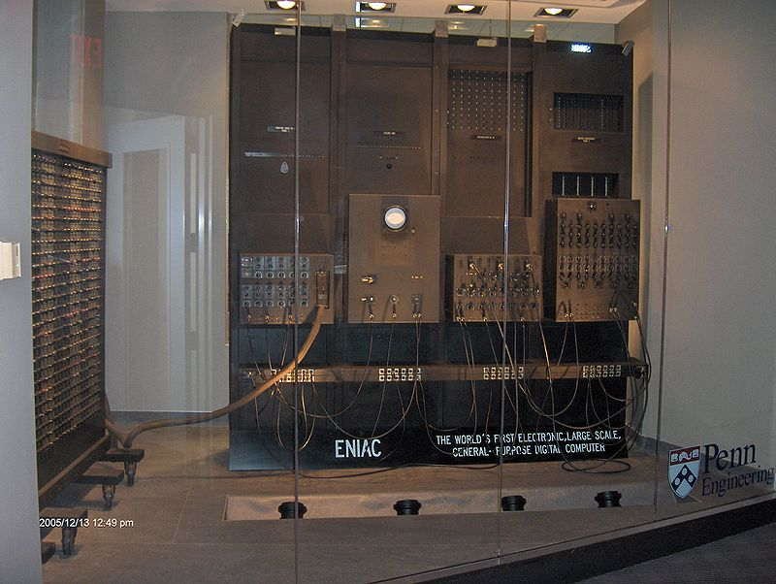
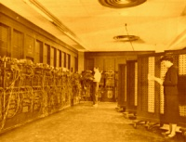
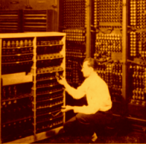
2. ENIAC I (Electrical Numerical Integrator And Calculator) U.S,
1943

Slide 4
Question:
What features or core principals of these devices exist in today’s computers ?

Slide 5
ENIAC I Mauchly & Eckert, Moore School U.S.A, 1943
One year to design and 18 months to build cost $500,000.
Physical specification:
17,468 vacuum tubes, along with 70,000 resistors, 10,000 capacitors, 1,500 relays, 6,000 manual switches and 5 million soldered joints.
1800 square feet (167 square meters) of floor space.
Weighed 30 tons.
Consumed 160 kilowatts of electrical power.

Slide 6
Technical Specification:
First Electrical (Vacuum tubes) computer.
Programmable with cables
Performance: 5,000 additions, 357 multiplications or 38 divisions in 1 sec
Purpose:
Calculations for the design of a hydrogen bomb, weather prediction, cosmic-ray studies, thermal ignition, random-number studies and wind-tunnel design.

Slide 7
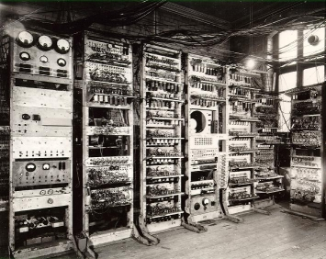
3. Manchester Mark 1, U.K 1949
Physical Specification:
Several tonnes.
10 kW.
3 m high
Technical:
Electrical.
Binary data representation.
5 K bytes memory.
Programmable using magnetic drum.
Purpose:
Scientific

Slide 8
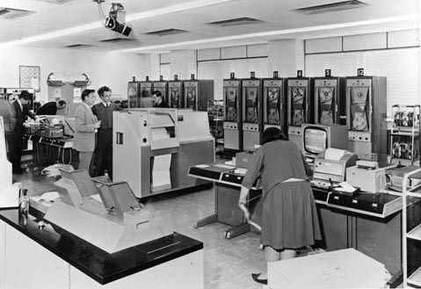
Ferranti Commercial version of the Manchester MK 1 (1955-1960s)

Slide 9
Questions:
What was the User Interface between humans and Computers in the early machines?
What were the applications for these machines ?
What limited their application to solving problems?

Slide 10
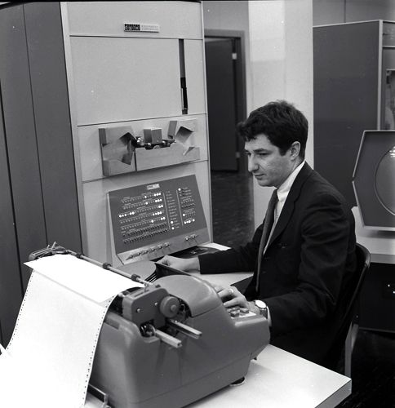
4. DEC PDP-1 (Mini Computer) 1960s
Electrical (Transistors)
Cost $ 100,000 +
Programming languages e.g. COBOL, FORTRAN
Paper card entry/Paper output
General purpose/big business

Slide 11
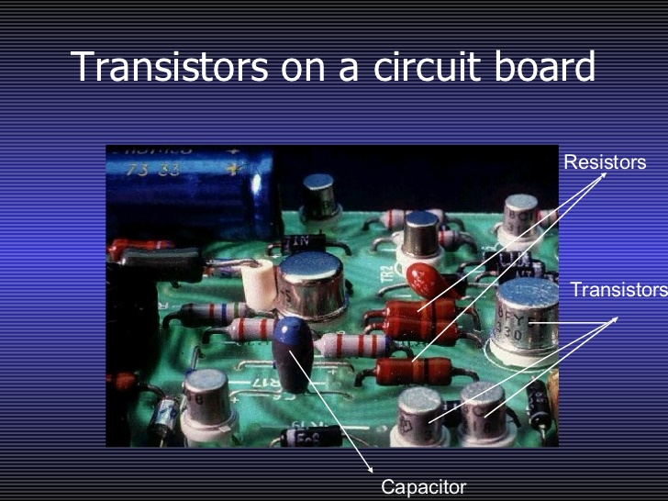

Slide 12
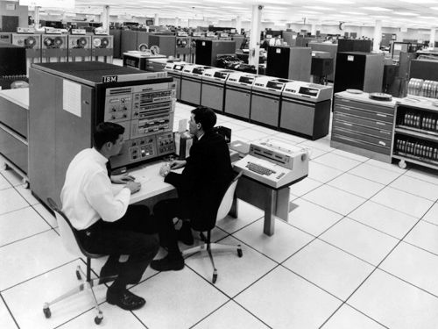
5. IBM 360 (Main Frame) 1960 -80s
Integrated circuit (Electronic)
Cost$ 500,000 +
€5 Billion investment by IBM
Paper card entry/Paper output
Large magnetic memory Mb
General purpose/big business
Airline bookings

Slide 13
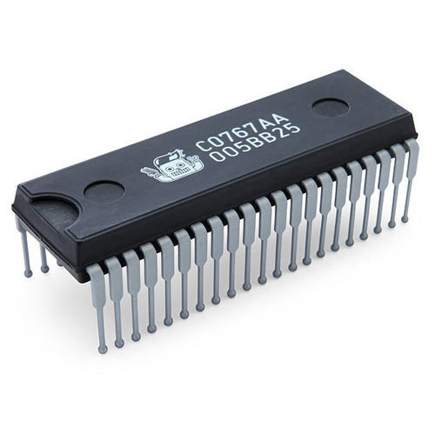
Integrated Circuit

Slide 14
Main Frame Issues :
Large room & Air-conditioning.
Management team.
Large power requirement kW.
Operated by professionals.
Basic input/Output: Cards, Teletype, Paper.
Vendor sells H/w & S/w: Limited choice, not competitive.
Annual maintenance fee = 15-20% of purchase price.

Slide 15
6. Mini Computer & PC Evolution 1980s-1990s

Slide 16
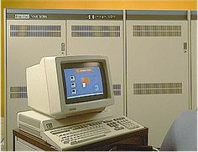
6.a Mini Computer
1980 – 1990.
10-200 users.
1-16Mbyte Main memory
Input/Output: “Terminals”
+ paper
Large room with Aircon.
Vendor H/ware= S/ware
DEC (VAX), IBM, HP
DEC was Ireland’s largest Computer manufacturer, 5,000+ employed in Galway (1972 – 1993)

Slide 17
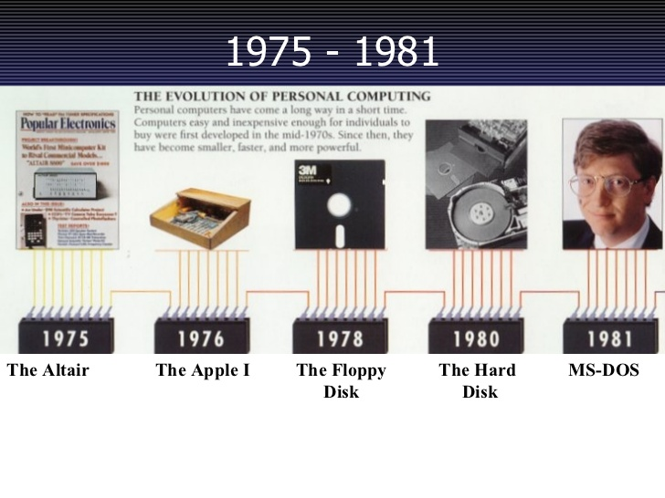
Mainframe and Minicomputer manufacturers considered PCs as hobbyist Toys (1975-1985)

Slide 18
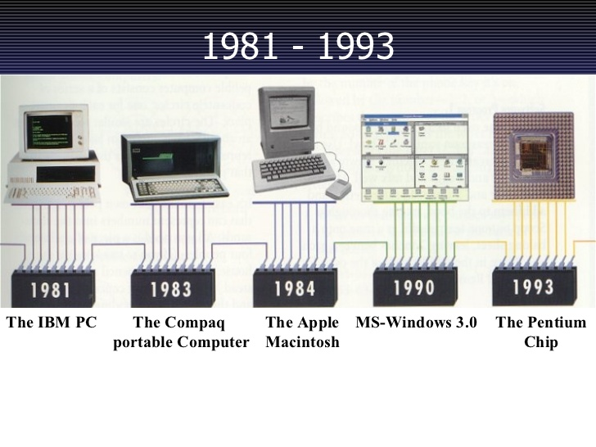

Slide 19
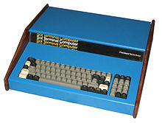
6.b First PC
Home Brew Club 1977 (Steve Wozniak, APPLE founder)
All-in-one system. Sol-20 computer, – QWERTY keyboard, CPU, display card, memory and ports. The systems were packaged with a cassette tape interface for storage and a 12" monochrome monitor . Complete with a copy of BASIC, the system sold for US$2,100.

Slide 20
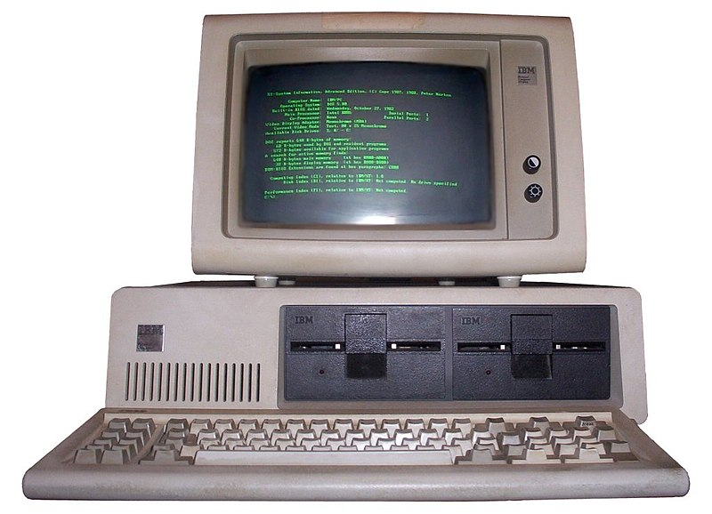
6.c 1981-90 IBM PC
Intel 8088 + processors
Open source s/ware
DOS evolving to Windows.
IC technology, 30k transistors.
Mouse devices appear
4 Mhz Clock.
Floppy disks.
Hard disks/19-256kb Main memory

Slide 21
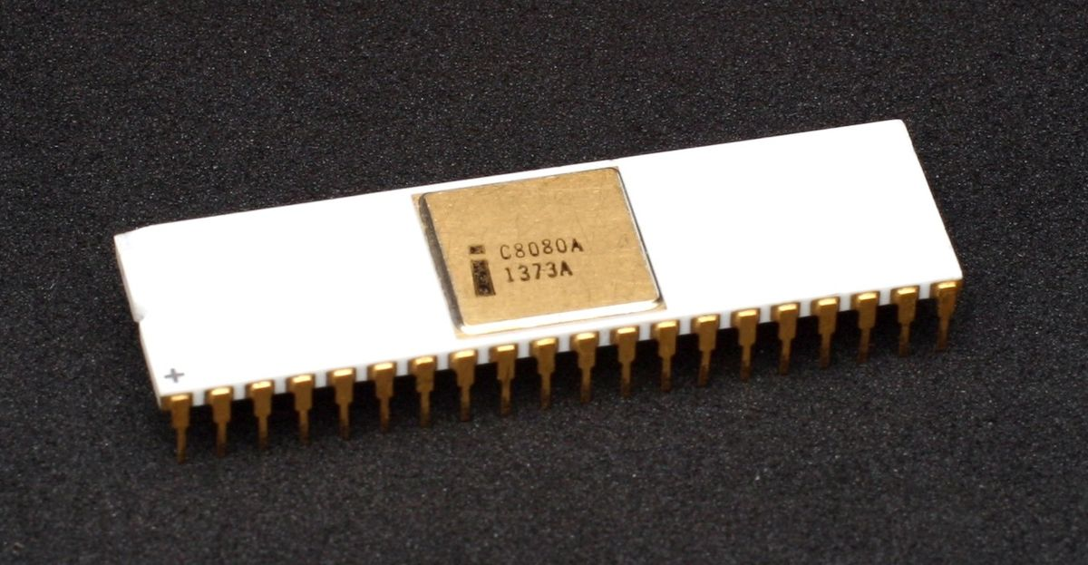
Intel 8080 (1974) Family
Processor Clock : 2 to 3 MHz
Transistors: 10k (3k Gates)
Power: 1-10 Watt.
Cost: $300

Slide 22
PC Advantages:
Ordinary office space is adequate.
No management team.
A lot cheaper than mainframes and mini computers.
3rd party s/ware vendor: Greater choice, more competitive pricing.
I/O: K/board, Mouse, printers, Floppy disks.
Processing Speed & Performance follows advances in IC technology (see Moore’s Law).
Slower than Mainframes & Minis in 1980
Faster than minis in 1990s.
Competing with Mainframes in 1990s.
16 Mb Main memory (1990)

Slide 23
Question:
How did the PCs improve the human GUI (General User Interface) ?

Slide 24
Memory
Memory is the area in a computer system where data is stored. In the simplest context there are two types of memory:
RAM (Primary memory)
Disk (Storage)
Cost of 1 MB Disk : Cost of 1 MB RAM :
1969: $1 Million
1980: $200 1980: $10,000
1990: $10 1990: $100
2010: $0.00001 2010 : $0.01

Slide 25
Consequences of memory costs
1970-1990s computers were memory-bound
Data was mainly Text.
No images or photos (1 Photo jpeg = 5-10 MB 2018)
Storing any large amount of data was very costly.
Data Analytics didn’t exist.
Many companies today wouldn’t be able to exist if memory wasn’t so cheap.

Slide 26
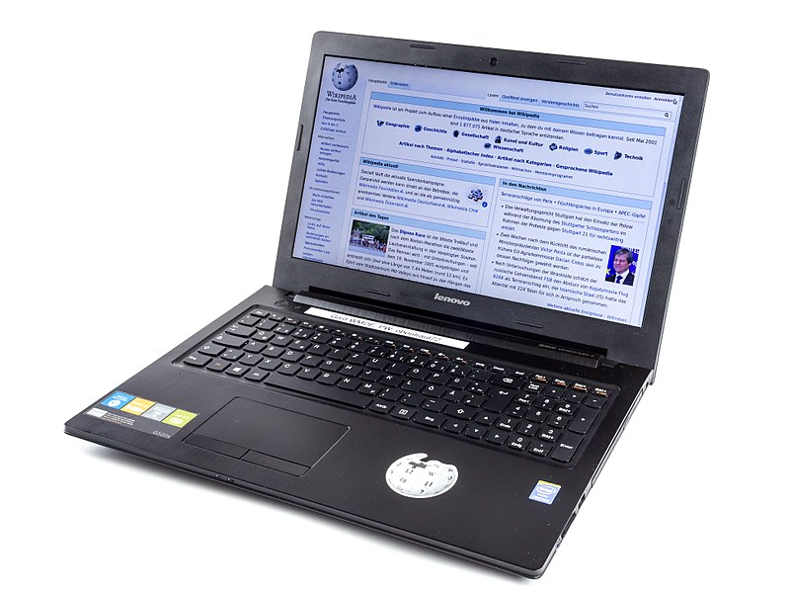
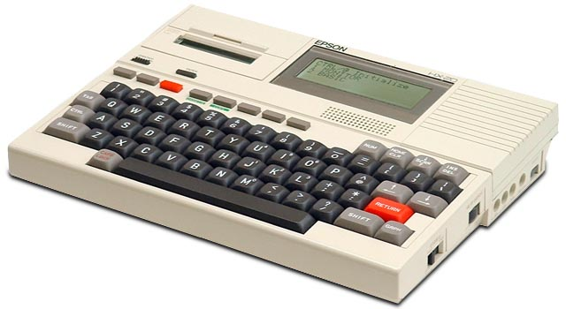
7. Lap tops (Notepads) 1995-
Lap top 2010-: High quality LED screen, Intel Core i5, 2.7GHz Clock, 8GB of RAM, 500GB hard drive,Battery, Internet, WiFi, 1Kg, €800.
Lap top 1980: Calculator display, 64kB, 8 bit processor, 4 MHz, Clock Mains supply, no internet, 12 Kg, $6,000.

Slide 27
Question:
How important is power and weight in computing ?

Slide 28
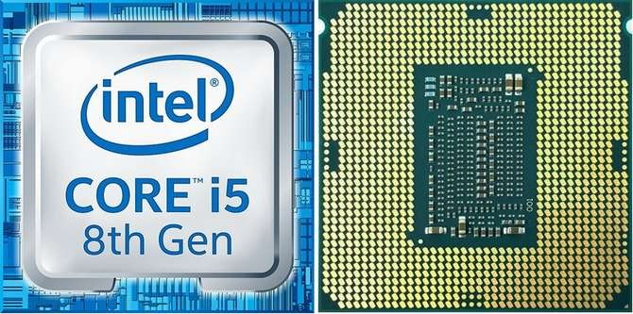
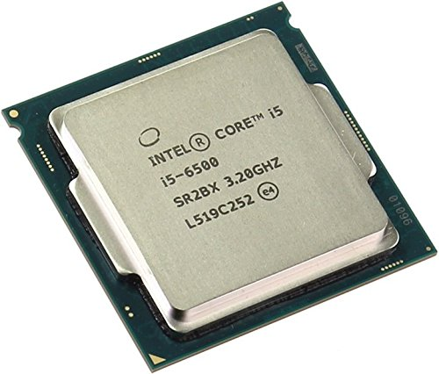
2010- Intel Processors
Cost: €300
Power consumption: 140 Watts
Pin connectors are on chip underside
Processors are termed Dual or Quad Core meaning each processor has 2 or 4 CPUs.
Processors have 2,500,000,000 transistors

Slide 29
Questions:
Who are the top 3 chip companies in the world by revenue ?
What are the name of the chips that they make ?
Do any of the chips have special purposes ?

Slide 30
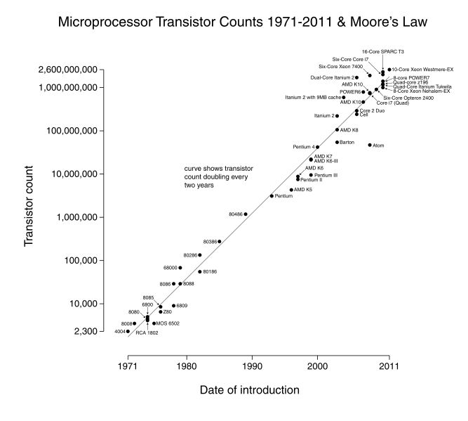

Slide 31
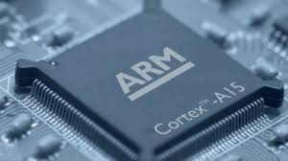
8. 2010- Mobile Computing
ARM Cortex-A53:
ARM has 95% of mobile market
Tech Specification
Power consumption: 0.1 – 1 Watt
Clock: 2 GHz clock,
Transistor count: 300-700,000,000
Battery powered.
The iPhone6 uses the Apple A8 processor. It is a 64-bit , dual-core ARM-based chip running a 2 GHz. It contains 2 Billion transistors.

Slide 32
Questions:
ARM is a chip company but it doesn’t make chips . What does it sell ?
How did ARM start ?
Recently it was bought. For how much and by who ?
23 billion
4. What computer applications require low power ?

Slide 33
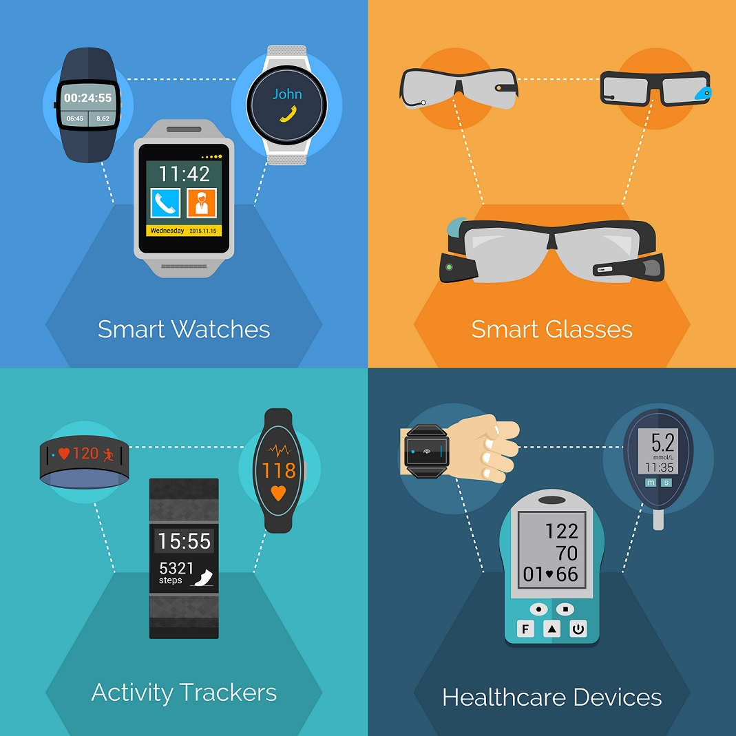
9. Present Wearable Devices

Slide 34
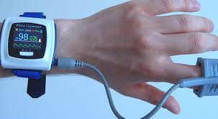
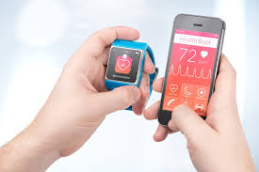

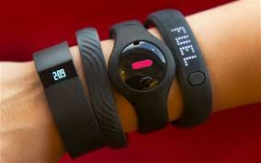
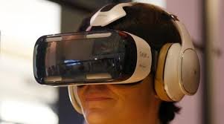

Slide 35
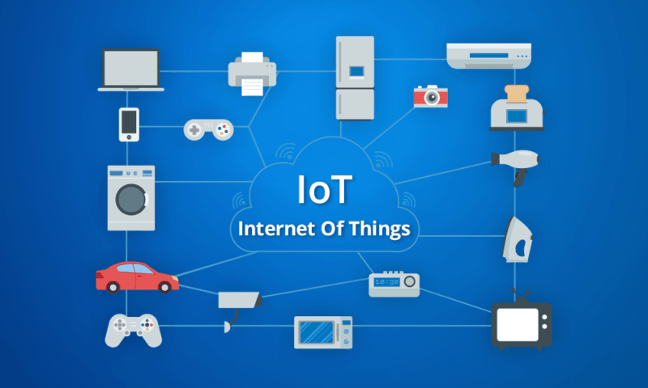
9. Internet of Things
By 2025 IoT will be a $14 Trillion Global business
By 2020 50 Billion devices will connected to the internet. More devices than humans.

Slide 36

10. Data Centres/The Cloud

Slide 37
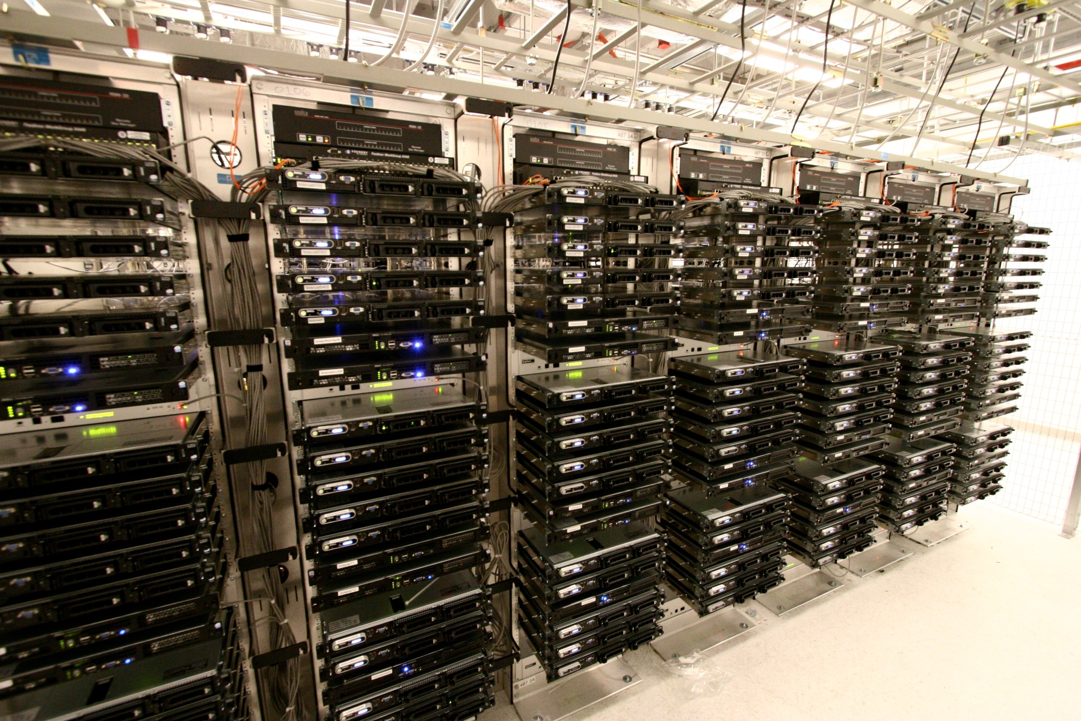
Server: A high performance computer consisting between 4 and 128 processors with memory
Central to the Cloud is the Data Centre:
100-100’s K of servers in air-conditioned warehouse size rooms

Slide 38
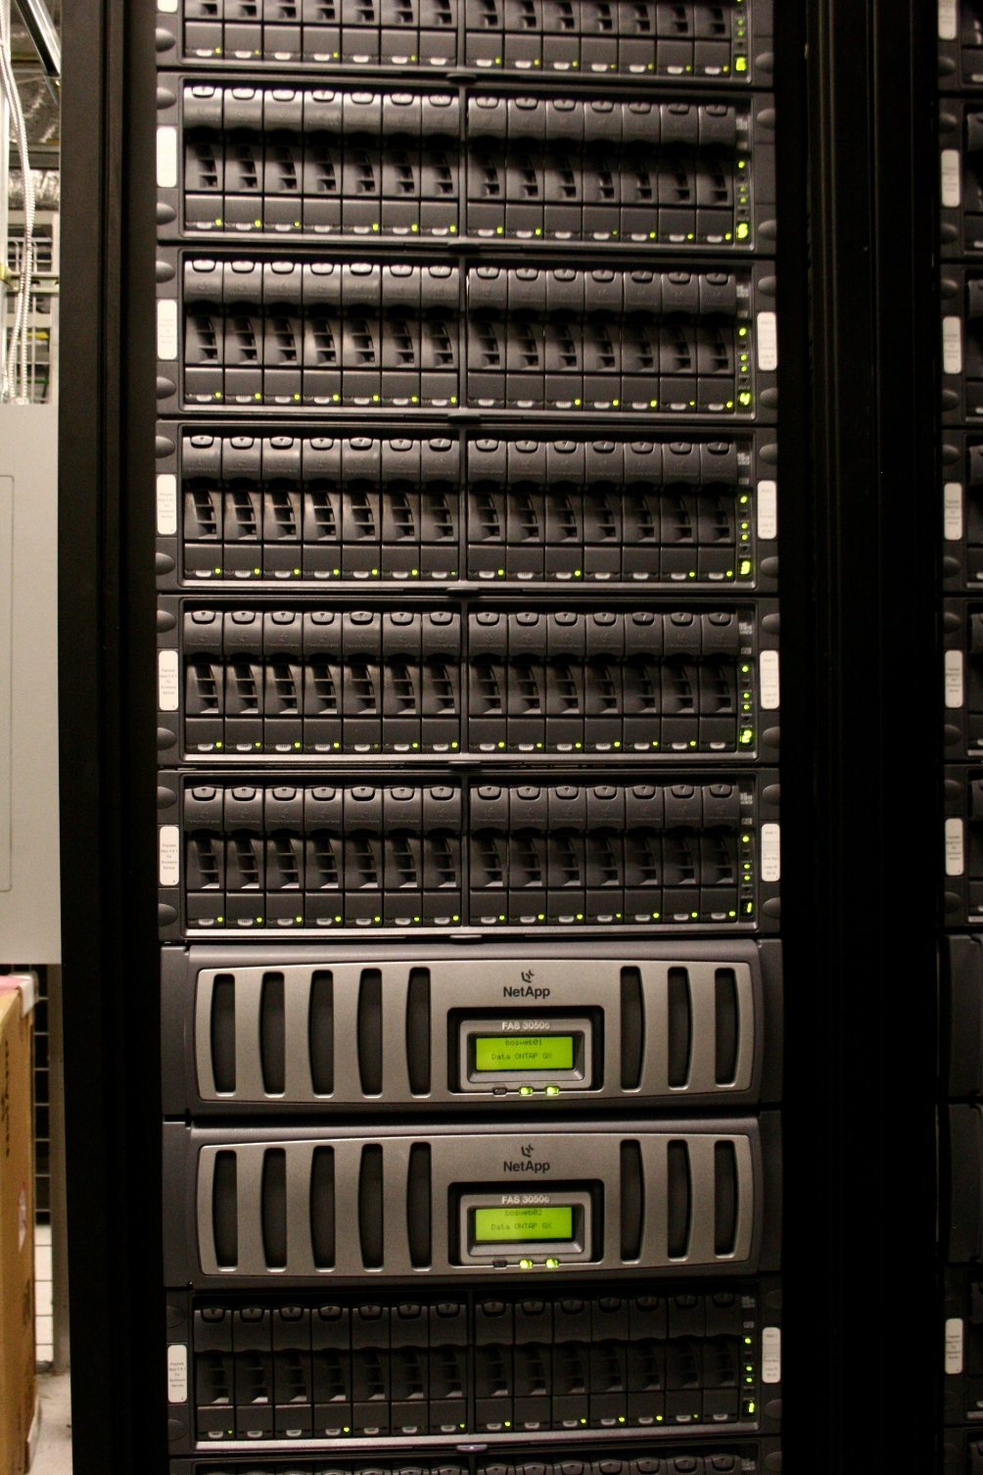
Aisles of Racks

Slide 39
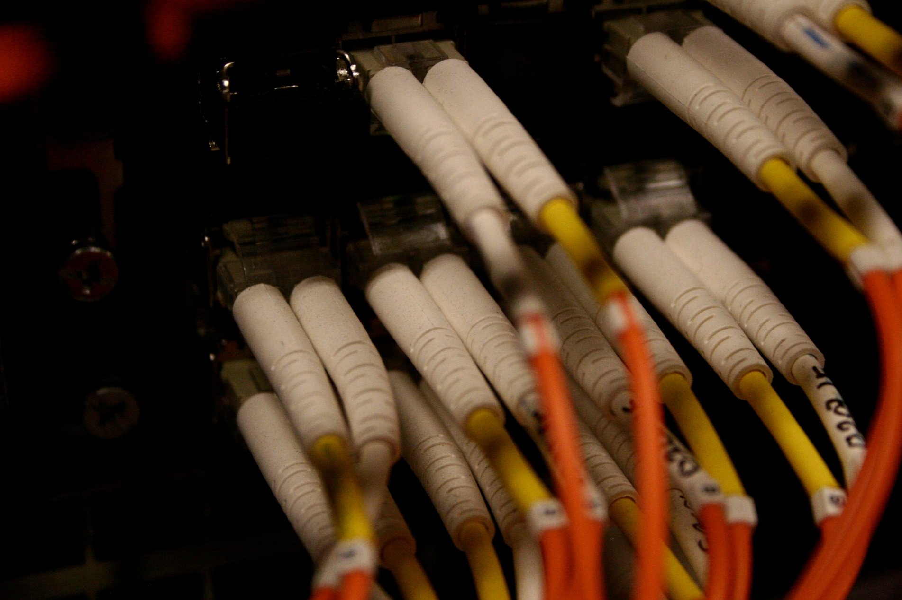
Masses of cabling
Servers are connected to users (laptops) over the internet. Users can be 1000 Kms away in other countries

Slide 40
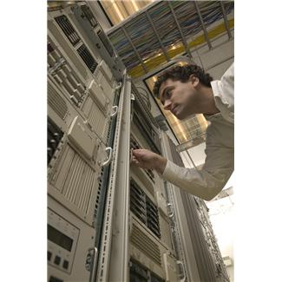
Highly Automated
and Huge Energy Consumer MWatts

Slide 41
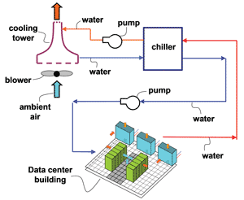

Slide 42
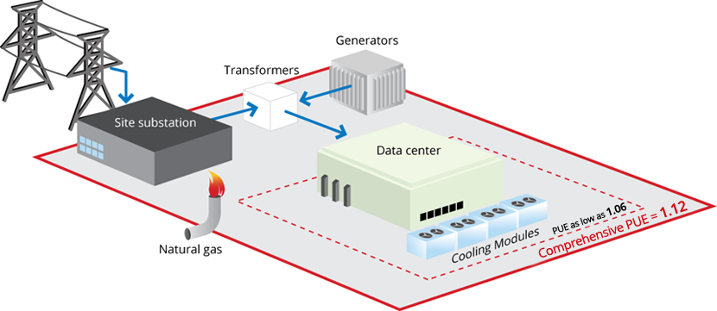

Slide 43
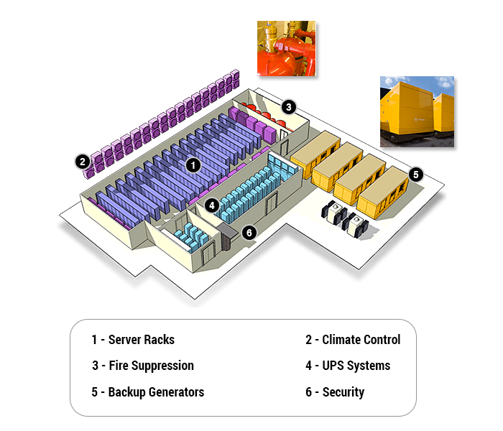

Slide 44
To save energy/cooling costs many data centres are built in cool/cold climates e.g. Ireland and Scandinavia.
Companies providing on-line services, Google, Facebook, Amazon use their own data centres. They also provide services to users via their data centres. Users pay for what they use: the software and the time they spend using the servers.

Slide 45
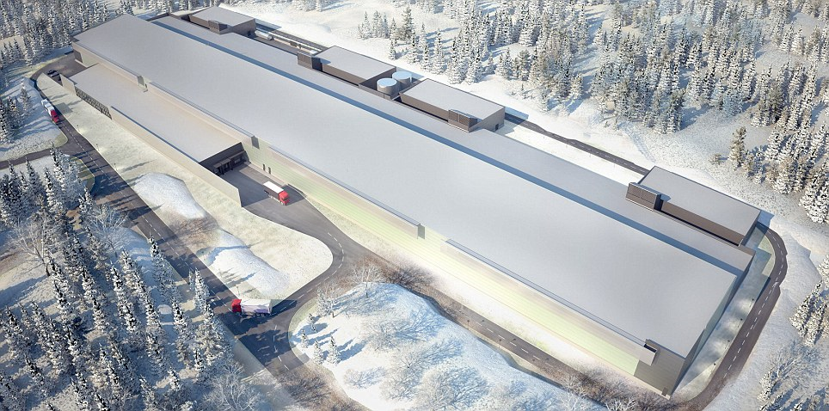
FaceBook Lulea Data Centre, Sweden. 28,000 sq m, 128 MW Hydro Power,
100,000 servers. Plans are being prepared for 1 Million server centres.

